Slide 1
CS 211 Computer Architecture Lecture 18 - 19: Floating Point Numbers
Ravi Mittal
ravi.mittal@iitgoa.ac.in
Indian Institute of Technology, Goa

Slide 2
Floating Point topics we will cover
Towards Floating Point Numbers
Scientific Notations
Floating Point Numbers
Floating Point – Special Cases
Limitations of Floating Point Numbers
Extra Slides - Backup

Slide 3
Reading and References
Computer System: A programmer’s Perspective, by Bryant and O’Hallaron, Chapter 2.4.2 on Floating Point Represenation
Prof Krste Asanović & Randy Katz, CS 61C: Computer Architecture, University of Berkeley, California
Nick Riasanovsky, CS 61C: Computer Architecture, University of Berkeley, California

Slide 4

Floating Point Quote
“95% of the folks out there are completely clueless about floating-point.”
James Gosling Feb. 28, 1998
James Gosling
Sun Fellow
Java Inventor
Ref: CS61-C –Univ of Berkeley, California

Slide 5
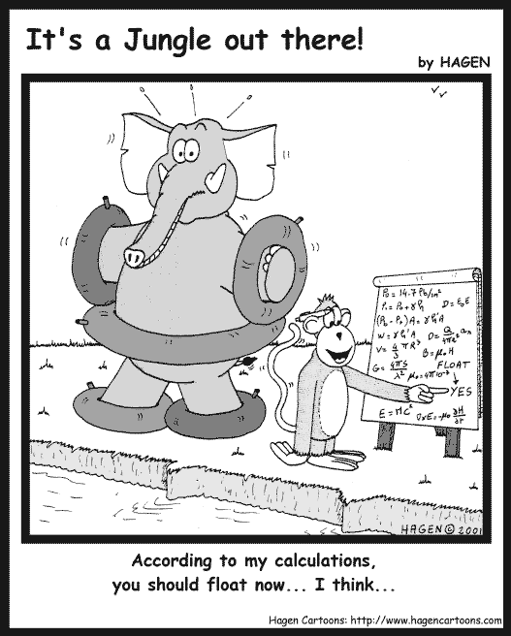
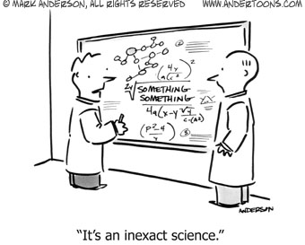
“According to my calculation,
you should float now ... I think ...”
“It’s an inexact science.”

Slide 6
Towards Floating Point Number

Slide 7
Reasoning about Fractions
Big Idea: Why can’t we represent fractions? Because our bits all represent nonnegative powers of 2.
Example: 10 1010_{two} = 1×2⁵ + 1×2³ + 1×2¹ = 42_{ten}
The lowest power of 2 is 2⁰, so the smallest difference between any two numbers is 2⁰ = 1.
Example: 10 1011_{two} = 42+1 = 43_{ten}
Example 6-bit representation:
0b xx xxxx
2⁵
2⁰
2⁴
2³
2²
2¹
Ref: CS61-C –Univ of California, Berkeley

Slide 8
Representation of Fractions
New Idea: Introduce a fixed “Binary Point” that signifies boundary between negative and nonnegative powers:
Example: 10.1010_{two} = 1×2¹ + 1×2⁻¹ + 1×2⁻³ = 2.625_{ten}
Binary point numbers that match the 6-bit format above range from 0 (00.0000_{two}) to 3.9375 (11.1111_{two})
Example 6-bit representation:
0b xx.xxxx
2¹
2⁻⁴
2⁰
2⁻¹
2⁻²
2⁻³
Ref: CS61-C –Univ of California, Berkeley

Slide 9
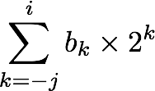
Fractional Binary Numbers
2^{i}
2^{i-1}
4
2
1
• • •
bi | bi-1 | ••• | b2 | b1 | b0 | b-1 | b-2 | b-3 | ••• | b-j
1/2
1/4
1/8
2^{-j}
• • •
Representation
Bits to right of “binary point” represent fractional powers of 2
Represents rational number:
Notes:
Latex source for equation: \sum_{k=-j}^i b_k \times 2^k

Slide 10
Fractional Binary Numbers: Examples
Value Representation
5 3/4 101.112
2 7/8 010.1112
Observations
Divide by 2 by shifting right
Multiply by 2 by shifting left
Numbers of form 0.111111…2 are just below 1.0
1/2 + 1/4 + 1/8 + … + 1/2^{i} + … ➙ 1.0
Notes:
ε : Epsilon

Slide 11
Representable Numbers
Limitation
Can only exactly represent numbers of the form x/2^{k}
Other rational numbers have repeating bit representations
Gives approximate number
Value Representation
1/3 0.0101010101[01]…2
1/5 0.001100110011[0011]…2
1/10 0.0001100110011[0011]…2

Slide 12
Number Representation Limitations
Given 32 bits (a word), what can we represent so far?
Signed and Unsigned Integers
4 Characters (ASCII)
Instructions and Addresses
How do we encode the following:
Real numbers (e.g. 3.14159)
Very large numbers (e.g. 6.02×10²³)
Very small numbers (e.g. 6.626×10⁻³⁴)
Special numbers (e.g. ∞, NaN)
Floating
Point
Ref: CS61-C –Univ of California, Berkeley
Notes:
We’re gonna be finishing up Number Representation.

Slide 13
Scientific Notations

Slide 14
Scientific Notation (Decimal)
significand
exponent
2.625_{ten} × 10²³
Normalized form: exactly one digit (non-zero) to left of decimal point (the point “floats” to be in the standard position)
Alternatives to representing 1/1,000,000,000
Normalized: 1.0×10⁻⁹
Not normalized: 0.1×10⁻⁸, 10.0×10⁻¹⁰
decimal point
radix (base)
Ref: CS61-C –Univ of California, Berkeley
Notes:
Begin this slide by remembering to say that in order to keep track of where the point “floats” to, we store that info in the exponent number

Slide 15
Scientific Notation (Binary)
exponent
significand
1.0101_{two} × 2¹
Computer arithmetic that supports this called floating point due to the “floating” of the binary point
Declare such variable in C as float
binary point
radix (base)
Ref: CS61-C –Univ of California, Berkeley

Slide 16
Translating To and From Scientific Notation
Consider the number 1.011_{two}×2⁴
To convert to ordinary number, shift the decimal to the right by 4
Result: 10110_{two} = 22_{ten}
For negative exponents, shift decimal to the left
1.011_{two}×2⁻² => 0.01011_{two} = 0.34375_{ten}
Go from ordinary number to scientific notation by shifting until in normalized form
1101.001_{two} => 1.101001_{two}×2³
Ref: CS61-C –Univ of California, Berkeley
Notes:
Put the point behind the first “significant” bit

Slide 17
Floating Point Numbers

Slide 18
Ariane 5
Ariane 5 - a heavy-lift space launch vehicle developed and operated by Arianespace for the European Space Agency. It was launched from the Centre Spatial Guyanais in French Guiana. It has been used to deliver payloads into geostationary transfer orbit or low Earth orbit.

Slide 19
This is important!
Ariane 5 explodes on maiden voyage: $500 MILLION dollars lost
64-bit floating point number assigned to 16-bit integer
Causes rocket to get incorrect value of horizontal velocity and crash
Patriot Missile defense system misses scud – 28 people die
System tracks time in tenths of second
Converted from integer to floating point number
Accumulated rounding error causes drift. 20% drift over 8 hours.
Eventually (on 2/25/1991 system was on for 100 hours) causes range mis-estimation sufficiently large to miss incoming missiles.

Slide 20
Goals of Floating Point
Support a wide range of values
Both very small and very large
Keep as much precision as possible
Help programmer with errors in real arithmetic
Support +∞, -∞, Not-A-Number (NaN), exponent overflow and underflow
Driven by numerical concerns
Positional notation is not effective in representing very large numbers
Representation of 5 × 2¹⁰⁰ would consist of the bit pattern 101 followed by 100 zeros
Ref: CS61-C –Univ of California, Berkeley
Notes:
Want floating point to look more “”natural” in that small unsigned value -> small floating point value

Slide 21

“Father” of Floating Point Standard
IEEE Standard 754 for Binary Floating-Point Arithmetic
1989 ACM Turing Award Winner!
Prof. Kahan
Prof. Emeritus
UC Berkeley
www.cs.berkeley.edu/~wkahan/ieee754status/754story.html
Ref: CS61-C –Univ of California, Berkeley
Notes:
1:30 in

Slide 22
Floating Point Encoding
Use normalized, Base 2 scientific notation: +1.xxx…x_{two}×2^{yyy…y}two
Split a 32-bit word into 3 fields:
S represents Sign (1 is negative, 0 positive)
Exponent represents y’s
Significand represents x’s
Key Idea: More like Sign and Magnitude
31 30
23 22
0
S
Exponent
Significand
1 bit
8 bits
23 bits
Ref: CS61-C –Univ of California, Berkeley
Notes:
Woah! We are splitting a 32 bit number into three fields. Does this look familiar? YES. Just like instructions formats!

Slide 23
Comparisons
Which is smaller? (i.e. closer to -∞)
0 or 1 x 10⁻¹²⁷ ?
1 x 10⁻¹²⁶ or 1 x 10⁻¹²⁷ ?
-1 x 10⁻¹²⁷ or 0 ?
-1 x 10⁻¹²⁶ or -1 x 10⁻¹²⁷ ?
Which is smaller? (i.e. closer to -∞)
0 or 1 x 10⁻¹²⁷ ?
1 x 10⁻¹²⁶ or 1 x 10⁻¹²⁷ ?
-1 x 10⁻¹²⁷ or 0 ?
-1 x 10⁻¹²⁶ or -1 x 10⁻¹²⁷ ?
Which is smaller? (i.e. closer to -∞)
0 or 1 x 10⁻¹²⁷ ?
1 x 10⁻¹²⁶ or 1 x 10⁻¹²⁷ ?
-1 x 10⁻¹²⁷ or 0 ?
-1 x 10⁻¹²⁶ or -1 x 10⁻¹²⁷ ?
Which is smaller? (i.e. closer to -∞)
0 or 1 x 10⁻¹²⁷ ?
1 x 10⁻¹²⁶ or 1 x 10⁻¹²⁷ ?
-1 x 10⁻¹²⁷ or 0 ?
-1 x 10⁻¹²⁶ or -1 x 10⁻¹²⁷ ?
Which is smaller? (i.e. closer to -∞)
0 or 1 x 10⁻¹²⁷ ?
1 x 10⁻¹²⁶ or 1 x 10⁻¹²⁷ ?
-1 x 10⁻¹²⁷ or 0 ?
-1 x 10⁻¹²⁶ or -1 x 10⁻¹²⁷ ?
Ref: CS61-C –Univ of California, Berkeley

Slide 24
The Exponent Field
Use biased notation
Read exponent as unsigned, but with bias of 127
Exp field ranges from -127 (00000000_{two}) to 128 (11111111_{two})
Exponent 0 is represented as 01111111_{two} = 127_{ten}
To encode in biased notation, add the bias (add 127) then encode in unsigned:
If we had 2¹, exp = 1 => 128 => 10000000_{two}
2¹²⁷: exp = 127 => 254 => 11111110_{two}
Ref: CS61-C –Univ of California, Berkeley

Slide 25
The Exponent Field
Why use biased notation for the exponent?
Remember that we want floating point numbers to look small when their actual value is small
We don’t like how in 2’s complement, -1 looks bigger than 0. Bias notation preserves the linearity of value
Recall that only the first bit denotes sign
Thus, floating point resembles sign and magnitude
magnitude
31 30
23 22
0
S
Exponent
Significand
1 bit
8 bits
23 bits
Ref: CS61-C –Univ of California, Berkeley

Slide 26
Floating Point Encoding
What does this mean?
Think of it as: (1 + Value of Significand)
Since the Significand represents all the negative powers of 2, its total value is always < 1
Example: 1.0101_{two} = 1 + 2⁻² + 2⁻⁴ = 1.3125
31 30
23 22
0
S
Exponent
Significand
1 bit
8 bits
23 bits
(-1)^{S} x (1 . Significand) x 2^{(Exponent-127)}
Ref: CS61-C –Univ of California, Berkeley
Notes:
Why have the 1? Be sneaky and save a bit
Add animations

Slide 27
Floating Point Encoding
Note the implicit 1 in front of the Significand
Ex: 0011 1111 1100 0000 0000 0000 0000 0000_{two}
(-1)⁰ x (1 . 1_{two}) x 2⁽¹²⁷⁻¹²⁷⁾ = (1 . 1_{two}) x 2⁽⁰⁾
1.1_{two} = 1.5_{ten}
Gives us an extra bit of precision
31 30
23 22
0
S
Exponent
Significand
1 bit
8 bits
23 bits
(-1)^{S} x (1 . Significand) x 2^{(Exponent-127)}
Ref: CS61-C –Univ of California, Berkeley
Notes:
Tell them to remember the number 23!!!!

Slide 28
Precision options
Single precision: 32 bits
Double precision: 64 bits
Other formats: half precision, quad precision
s | exponent | Frac or Significand
1 | 8-bits | 23-bits
s | exponent | Frac pr Significand
1 | 11-bits | 52-bits

Slide 29
Single Precision - Notation
s | Exponent | Fraction or Significand
1 | 8-bits | 23-bits
S: sign bit (0 ⇒ non-negative, 1 ⇒ negative)
Normalize significand: 1.0 ≤ |significand| < 2.0
Always has a leading pre-binary-point 1 bit, so no need to represent it explicitly (hidden bit)
Significand is Fraction with the “1.” restored
Exponent: excess representation: actual exponent + Bias
Ensures exponent is unsigned
Single: Bias = 127; Double: Bias = 1203

Slide 30
Precision and Accuracy
Don’t confuse these two terms!
Precision is a count of the number of bits in a computer word used to represent a value
Accuracy is a measure of the difference between the actual value of a number and its computer representation
High precision permits high accuracy but doesn’t guarantee it. It is possible to have high precision but low accuracy.
Example: float pi = 3.14;
pi will be represented using all 24 bits of the significand (highly precise), but is only an approximation (not accurate)
Ref: CS61-C –Univ of California, Berkeley
Notes:
Maybe cut out this slide. Not relevant

Slide 31
Floating Point – Special Cases

Slide 32
Floating Point Numbers - Special Cases
Exponent | Significand | Meaning
0x00 | ? | ?
0x00 | ? | ?
0x01 – 0xFE | anything | ± Num
0xFF | ? | ?
0xFF | ? | ?
Ref: CS61-C –Univ of California, Berkeley

Slide 33
Representing Zero
But wait… what happened to zero?
Using standard encoding 0x00000000 is 1.0×2⁻¹²⁷≠0
This is because of implicit 1
Special case: Exp and Significand all zeros = 0
Two zeros! One for each sign bit +0 and -0
So, coded 0x00000000 = 0
Ref: CS61-C –Univ of California, Berkeley
Notes:
Fix slides so looks pretty

Slide 34
Floating Point Numbers - Special Cases
Exponent | Significand | Meaning
0x00 | 0 | ± 0
0x00 | ? | ?
0x01 – 0xFE | anything | ± Num
0xFF | ? | ?
0xFF | ? | ?
Ref: CS61-C –Univ of California, Berkeley

Slide 35
Representing Very Small Numbers
What are the normal numbers closest to 0? (here, normal means the exponent is nonzero)
a = 1.0…00_{two}×2¹⁻¹²⁷ = (1+ 0 ) x 2⁻¹²⁶ = 2⁻¹²⁶
b = 1.0…01_{two}×2¹⁻¹²⁷ = (1+2⁻²³) x 2⁻¹²⁶ = 2⁻¹²⁶ + 2⁻¹⁴⁹
Gaps!
b
+∞
-∞
0
a
The gap between 0 and a is 2⁻¹²⁶
The gap between a and b is 2⁻¹⁴⁹
We want to represent numbers between 0 and a
How? The implicit 1 forces the 2⁻¹²⁶ term to stay
Solution: Take out the implicit 1 (becomes denorm)
Special case: Exp = 0, Significand ≠ 0 are denorm numbers
Ref: CS61-C –Univ of California, Berkeley

Slide 36
Denorm Numbers
Short for “denormalized numbers”
No leading 1
Careful! Denorm exponent bias is now 126 when Exp = 0x00
Now what do the gaps look like?
Smallest denorm: ± 0.0…01_{two}×2⁻¹²⁶ = ± 2⁻¹⁴⁹
Largest denorm: ± 0.1…1_{two}×2⁻¹²⁶ = ± (2⁻¹²⁶ – 2⁻¹⁴⁹)
Smallest norm: ± 1.0…0_{two}×2⁻¹²⁶ = ± 2⁻¹²⁶
So much closer to 0
No uneven gap! Increments by 2⁻¹⁴⁹
Ref: CS61-C –Univ of California, Berkeley
Notes:
Here’s another exercise: reason about why the denorm bias is 126 by trying to evaluate the two floating point number that surround a in the previous slide

Slide 37
Floating Point Numbers - Special Cases
Exponent | Significand | Meaning
0x00 | 0 | ± 0
0x00 | non-zero | ± Denorm Num
0x01 – 0xFE | anything | ± Num
0xFF | ? | ?
0xFF | ? | ?
Ref: CS61-C –Univ of California, Berkeley

Slide 38
Other Special Cases
Exp = 0xFF, Significand = 0: ± ∞
e.g. division by 0
Still work in comparisons
Exp = 0xFF, Significand ≠ 0: Not a Number (NaN)
e.g. square root of negative number, 0/0, ∞–∞
NaN propagates through computations
In theory: Significand can be useful for debugging
Largest value (besides ∞)?
Exp = 0xFF has now been taken! Exp = 0xFE has largest: 1.1…1_{two}×2¹²⁷ = 2¹²⁸ – 2¹⁰⁴
Ref: CS61-C –Univ of California, Berkeley
Notes:
Remind students that there are different types of NaNs but they won’t be tested on them,they just needa know what the range of all NaNs are

Slide 39
Floating Point Numbers - Special Cases
Exponent | Significand | Meaning
0x00 | 0 | ± 0
0x00 | non-zero | ± Denorm Num
0x01 – 0xFE | anything | ± Num
0xFF | 0 | ± ∞
0xFF | non-zero | NaN
Ref: CS61-C –Univ of California, Berkeley

Slide 40
Limitations of Floating Point Numbers

Slide 41
Floating Point Limitations (1/2)
What if result x is too large? (abs(x)> 2¹²⁸)
Overflow: Exponent is larger than what can be represented
What if result x too small? (0 < abs(x)< 2⁻¹⁴⁹)
Underflow: Negative exponent is larger than can be represented
What if result runs off the end of the Significand?
Rounding occurs and can lead to unexpected results
FP has different rounding modes
overflow
underflow
overflow
-2¹²⁸
-1
-2⁻¹⁴⁹
0
2⁻¹⁴⁹
1
2¹²⁸
Ref: CS61-C –Univ of California, Berkeley
Notes:
Have another slide explaining about the gaps that come about when the exponent field changes
Remember that we can only represent 2³² distinct things. Just bc we have a bigger range doesnt mean we get more numbers. We lose precision as we have higher exponents

Slide 42
Floating Point Limitations (2/2)
FP addition is NOT associative!
You can find Big and Small numbers such that: Small + Big + Small ≠ Small + Small + Big
This is due to rounding errors: FP approximates results because it only has 23 bits for Significand
Despite being seemingly “more accurate,” FP cannot represent all integers
e.g. 2²⁴ + 2²³ + 1 = 25165825 (try it!)
Be careful when casting between int and float
Ref: CS61-C –Univ of California, Berkeley
Notes:
Information can get lost when casting between int and float (in both directions!)
Some optimizations change the ordering of FP operations, which can lead to errors.

Slide 43
Normalized Encoding Example
v = (–1)^{s} M 2E
E = exp – Bias
Value: float F = 15213.0;
15213₁₀ = 11101101101101₂
= 1.1101101101101₂ x 2¹³
Significand
M = 1.1101101101101₂
frac = 11011011011010000000000₂
Exponent
E = 13
Bias = 127
exp = 140 = 10001100₂
Result: 0 10001100 11011011011010000000000
s
exp
frac

Slide 44
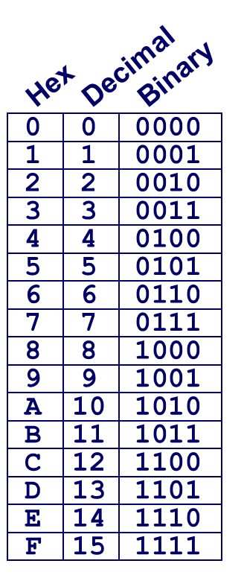
C float Decoding Example 1
v = (–1)^{s} M 2E
E = exp – Bias
float: 0xC0A00000
Bias = 2^{k-1} – 1 = 127
binary:
1 | 8-bits | 23-bits
E = 129
S = 1 -> negative number
M = 1.010 0000 0000 0000 0000 0000
M = 1 + 1/4 = 1.25
v = (–1)^{s} M 2E =

Slide 45
C float Decoding Example #1
v = (–1)^{s} M 2E
E = exp – Bias
float: 0xC0A00000
binary: 1100 0000 1010 0000 0000 0000 0000 0000
1 | 1000 0001 | 010 0000 0000 0000 0000 0000
1 | 8-bits | 23-bits
E = 129
S = 1 -> negative number
M = 1.010 0000 0000 0000 0000 0000
M = 1 + 1/4 = 1.25
v = (–1)^{s} M 2E =

Slide 46
C float Decoding Example #2
v = (–1)^{s} M 2E
E = exp – Bias
float: 0xC0A00000
Bias = 2^{k-1} – 1 = 127
binary: 1100 0000 1010 0000 0000 0000 0000 0000
1 | 1000 0001 | 010 0000 0000 0000 0000 0000
1 | 8-bits | 23-bits
E = exp – Bias = 129 – 127 = 2 (decimal)
S = 1 -> negative number
M = 1.010 0000 0000 0000 0000 0000
M = 1 + 1/4 = 1.25
v = (–1)^{s} M 2E = (-1)¹ * 1.25 * 2² = -5

Slide 47
C float Decoding Example #3
v = (–1)^{s} M 2E
E = 1 – Bias
float: 0x001C0000
binary: 0000 0000 0001 1100 0000 0000 0000 0000
0 | 0000 0000 | 001 1100 0000 0000 0000 0000
1 | 8-bits | 23-bits
E = 129
S = 1 -> negative number
M = 0.010 0000 0000 0000 0000 0000
M = 1 + 1/4 = 1.25
v = (–1)^{s} M 2E =

Slide 48
C float Decoding Example #2
v = (–1)^{s} M 2E
E = 1 – Bias
float: 0x001C0000
Bias = 2^{k-1} – 1 = 127
binary: 0000 0000 0001 1100 0000 0000 0000 0000
0 | 0000 0000 | 001 1100 0000 0000 0000 0000
1 | 8-bits | 23-bits
E = 1 – Bias = 1 – 127 = –126 (decimal)
S = 0 -> positive number
M = 0.001 1100 0000 0000 0000 0000
M = 1/8 + 1/16 + 1/32 = 7/32 = 7*2^{–5}
v = (–1)^{s} M 2E = (-1)⁰ * 7*2^{–5} * 2^{–126} = 7*2^{–131}
v ≈ 2.571393892 X 10^{–39}

Slide 49
Backup

Slide 50
Floating Point Representation
Example: 15213₁₀ = (-1)⁰ x 1.1101101101101₂ x 2¹³
Numerical Form: (–1)^{s} M 2E
Sign bit s determines whether number is negative or positive
Significand M normally a fractional value in range [1.0,2.0).
Ranges between 1 and 2 – ε ; or between 0 and 1 – ε
Exponent E weights value by power of two
Encoding
MSB s is sign bit s
exp field encodes E
frac field encodes M
s | exp | frac

Slide 51
Precision options
Single precision: 32 bits
Double precision: 64 bits
Other formats: half precision, quad precision
s | exp | frac
1 | 8-bits | 23-bits
s | exp | frac
1 | 11-bits | 52-bits

Slide 52
Single Precision
s | exp | frac
1 | 8-bits | 23-bits
S: sign bit (0 ⇒ non-negative, 1 ⇒ negative)
Normalize significand: 1.0 ≤ |significand| < 2.0
Always has a leading pre-binary-point 1 bit, so no need to represent it explicitly (hidden bit)
Significand is Fraction with the “1.” restored
Exponent: excess representation: actual exponent + Bias
Ensures exponent is unsigned
Single: Bias = 127; Double: Bias = 1203

Slide 53
Three “kinds” of floating point numbers
v = (–1)^{s} M 2E
s | exp | frac
1 | e-bits | f-bits
00…00
exp ≠ 0 and exp ≠ 11…11
11…11
denormalized
normalized
special

Slide 54
“Normalized” Values
v = (–1)^{s} M 2E
When: exp ≠ 000…0 and exp ≠ 111…1
Exponent coded as a biased value: E = exp – Bias
exp: unsigned value of exp field
Bias = 2^{k-1} - 1, where k is number of exponent bits
Single precision: 127 (exp: 1…254, E: -126…127)
Double precision: 1023 (exp: 1…2046, E: -1022…1023)
Significand coded with implied leading 1: M = 1.xxx…x2
xxx…x: bits of frac field
Minimum when frac=000…0 (M = 1.0)
Maximum when frac=111…1 (M = 2.0 – ε)
Get extra leading bit for “free”

Slide 55
“Normalized” Values
v = (–1)^{s} M 2E
When: exp ≠ 000…0 and exp ≠ 111…1
Exponent coded as a biased value: E = exp – Bias
exp: unsigned value of exp field
Bias = 2^{k-1} - 1, where k is number of exponent bits
Single precision: 127 (exp: 1…254, E: -126…127)
Double precision: 1023 (exp: 1…2046, E: -1022…1023)
Significand coded with implied leading 1: M = 1.xxx…x2
xxx…x: bits of frac field
Minimum when frac=000…0 (M = 1.0)
Maximum when frac=111…1 (M = 2.0 – ε)
Get extra leading bit for “free”

Slide 56
Single-Precision Range
v = (–1)^{s} M 2E
E = exp – Bias
Smallest value
Exponent: 00000001 ⇒ exponent E = 1 – 127 = –126
Fraction: 000…00 ⇒ significand = 1.0
±1.0 × 2^{–126} ≈ ±1.2 × 10^{–38}
Largest value
exponent: 11111110 ⇒ actual exponent E = 254 – 127 = +127
Fraction: 111…11 ⇒ significand ≈ 2.0
±2.0 × 2⁺¹²⁷ ≈ ±3.4 × 10⁺³⁸

Slide 57
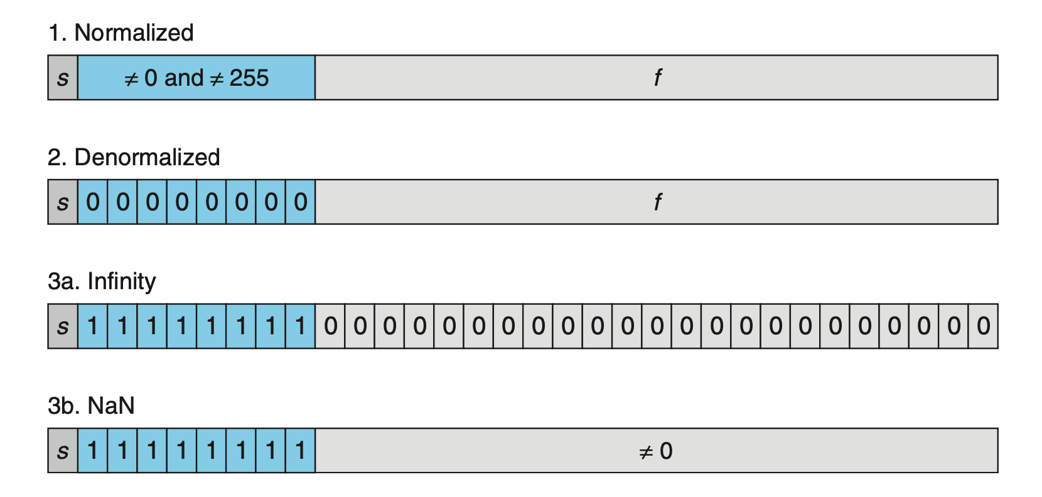
Categories of Floating Point numbers

Slide 58
Denormalized Values
v = (–1)^{s} M 2E
E = 1 – Bias
Condition: exp = 000…0
Exponent value: E = 1 – Bias (instead of exp – Bias) (why?)
Significand coded with implied leading 0: M = 0.xxx…x2
xxx…x: bits of frac
Cases
exp = 000…0, frac = 000…0
Represents zero value
Note distinct values: +0 and –0 (why?)
exp = 000…0, frac ≠ 000…0
Numbers closest to 0.0
Equispaced
Gradual underflow
Notes:
Denormalized numbers serve two purposes. First, they provide a way to represent numeric value 0, since with a normalized number we must always have M ≥ 1, and hence we cannot represent 0.
In fact, the floating-point representation of +0.0 has a bit pattern of all zeros: the sign bit is 0, the exponent field is all zeros (indicating a denormalized value), and the fraction field is all zeros, giving M = f = 0
Curiously, when the sign bit is 1, but the other fields are all zeros, we get the value −0.0. With IEEE floating-point format, the values −0.0 and +0.0 are considered different in some ways and the same in others.
A second function of denormalized numbers is to represent numbers that are very close to 0.0. They provide a property known as gradual underflow in which possible numeric values are spaced evenly near 0.0.

Slide 59
Special Values
Condition: exp = 111…1
Case: exp = 111…1, frac = 000…0
Represents value ∞ (infinity)
Operation that overflows- when we multiply two very large numbers or we divide by zero
Both positive and negative
E.g., 1.0/0.0 = −1.0/−0.0 = +∞, 1.0/−0.0 = −∞
Case: exp = 111…1, frac ≠ 000…0
Not-a-Number (NaN)
Represents case when no numeric value can be determined
E.g., sqrt(–1), ∞ − ∞, ∞ × 0
Sometimes one can represent uninitialized data with NaaN

Slide 60
Dynamic Range (s=0 only)
v = (–1)^{s} M 2E
norm: E = exp – Bias
denorm: E = 1 – Bias
s exp frac E Value
0 0000 000 -6 0
0 0000 001 -6 1/8*1/64 = 1/512
0 0000 010 -6 2/8*1/64 = 2/512
…
0 0000 110 -6 6/8*1/64 = 6/512
0 0000 111 -6 7/8*1/64 = 7/512
0 0001 000 -6 8/8*1/64 = 8/512
0 0001 001 -6 9/8*1/64 = 9/512
…
0 0110 110 -1 14/8*1/2 = 14/16
0 0110 111 -1 15/8*1/2 = 15/16
0 0111 000 0 8/8*1 = 1
0 0111 001 0 9/8*1 = 9/8
0 0111 010 0 10/8*1 = 10/8
…
0 1110 110 7 14/8*128 = 224
0 1110 111 7 15/8*128 = 240
0 1111 000 n/a inf
closest to zero
Denormalized
numbers
(-1)⁰(0+1/4)*2⁻⁶
largest denorm
smallest norm
(-1)⁰(1+1/8)*2⁻⁶
closest to 1 below
Normalized
numbers
closest to 1 above
largest norm

Slide 61
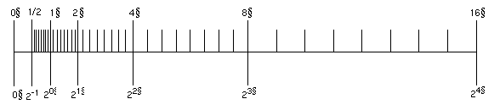
Floating Point Gaps
Does adding 0x00000001 always add the same value to the floating point number?
NO—it’s value depends on the exponent field
ex: 1.0_{two} x 2² = 4 1.0_{two} x 2³ = 8 1.1_{two} x 2² = 6 1.1_{two} x 2³ = 12
Thus floating points are quite different from the number representations you’ve learned so far
+2
+4
Notes:
Have another slide explaining about the gaps that come about when the exponent field changes
Remember that we can only represent 2³² distinct things. Just bc we have a bigger range doesnt mean we get more numbers. We lose precision as we have higher exponents

Slide 62
Floating Point Representation
Example: 15213₁₀ = (-1)⁰ x 1.1101101101101₂ x 2¹³
Numerical Form: (–1)^{s} M 2E
Sign bit s determines whether number is negative or positive
Significand M normally a fractional value in range [1.0,2.0).
Ranges between 1 and 2 – ε ; or between 0 and 1 – ε
Exponent E weights value by power of two
Encoding
MSB s is sign bit s
exp field encodes E
frac field encodes M
s | exp | frac

